Slide 1
Implementation of Augmented Reality for Digital Classroom Applications
Team members:
P.Chinmayee(17B91A12C7)
V. Bala Saraswati (17B91A12H1)
V. Bharathi Sri(17B91A12G7)
P. Sowmya(17B91A12D1)
Guide Name:
Dr. B.V.D.S.Sekhar
Associate Professor
Dept of IT
Department of Information Technology
Sagi Rama Krishnam Raju Engineering College, Bhimavaram.

Slide 2
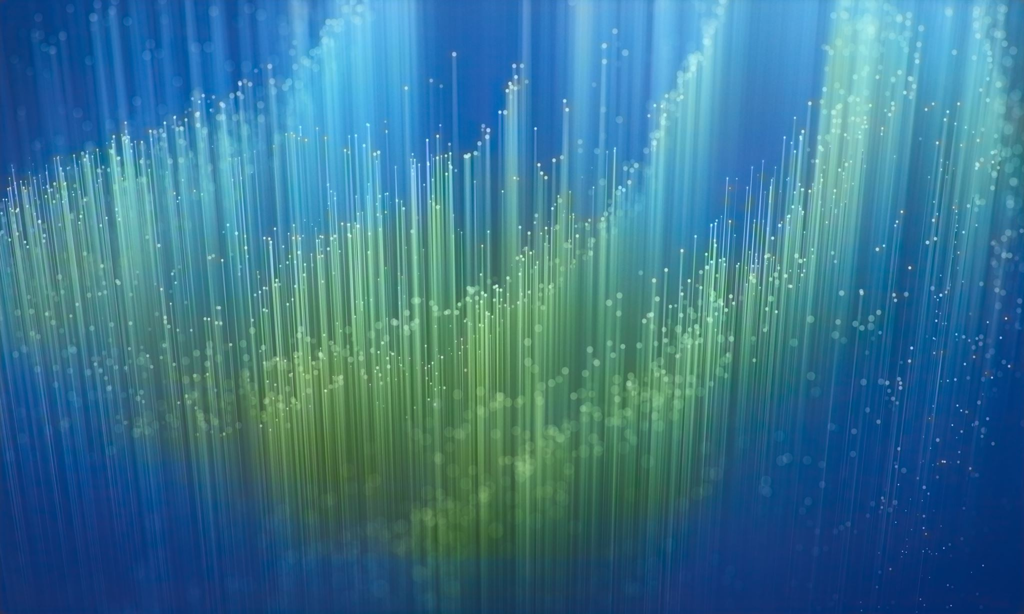
Table of Content:
Introduction
Problem Statement
Existing System
Proposed System
Literature Survey
Methodology

Slide 3
Introduction:
AR allows people to interact with their real-world environment in an enhanced way. A combination of a real scene viewed by a user and a virtual scene generated by a computer.
AR can promote interactive experiences with coursework, encourage collaboration between students, improve motivation, and increase learning gains.
Virtual reality (VR) refers to a computer-generated simulation in which a person can interact within an artificial three-dimensional environment using electronic devices
Virtual reality attempts to create an illusory environment that can be presented to our senses with artificial information, making our minds believe it is (almost) a reality.

Slide 4

Problem Statement:
Presenting corresponding lecture videos while teaching an online class is a major difficulty for lecturers. An automated Augmented reality app is designed in-order to ease their task. This app recognizes the hand gestures or image cards and plays the corresponding video to the students. In this way the task of lecturers to present the corresponding video without giving a pause to lecture becomes very easy. Lecturers can show the image cards to play a related video.

Slide 5
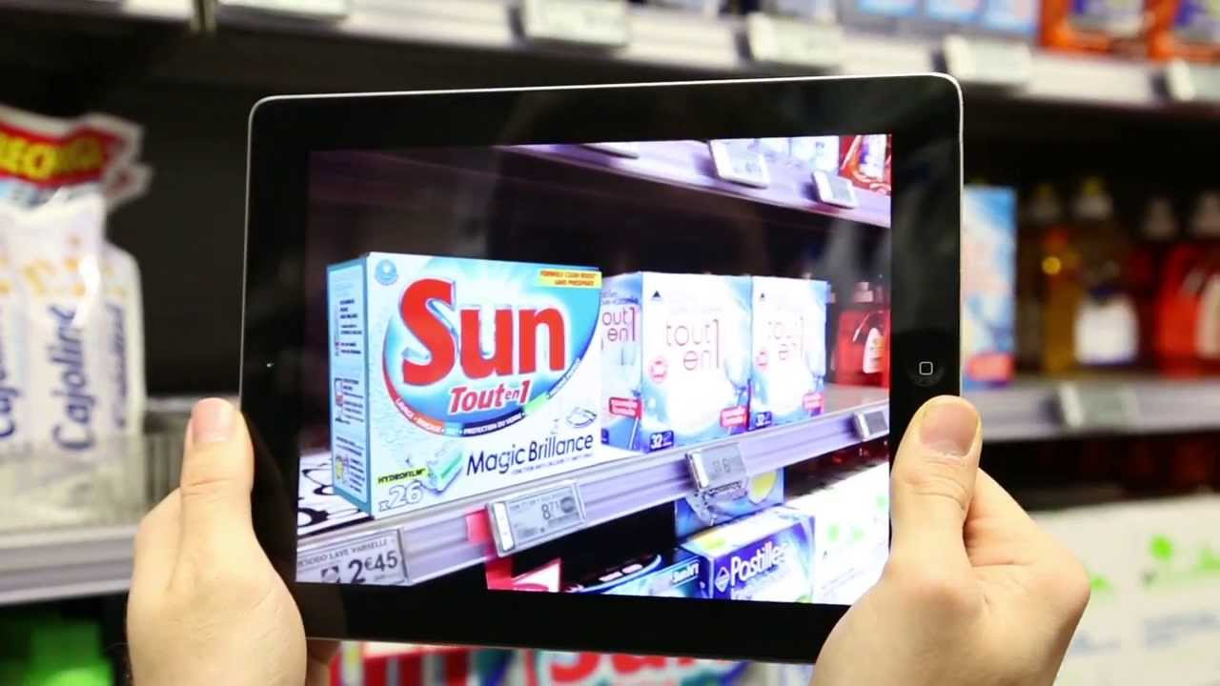
Existing System
In the existing Augmented Reality system we login into the user interface and scan an object with the camera, this will be compared with the images in the database and the details of the object in the database which is similar to scanned image, will be provided as the output in the user interface.
This system only provides the details of the object but what we aim in our project is to retrieve a video to a corresponding hand gesture.

Slide 6
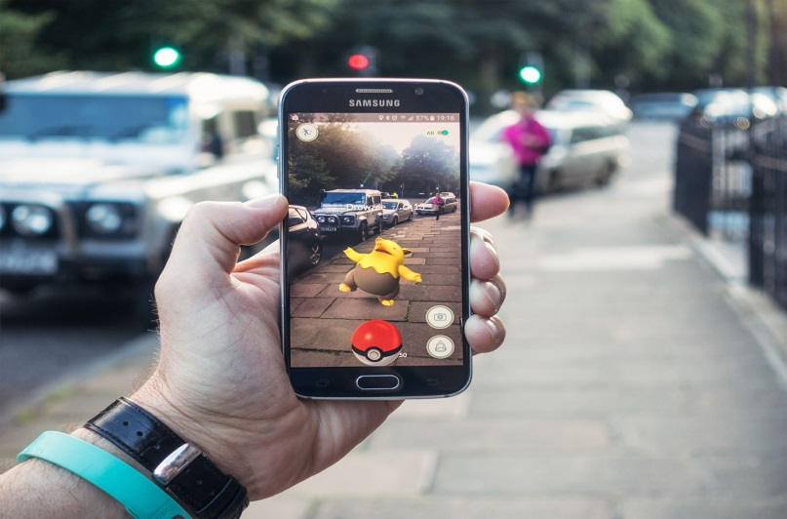
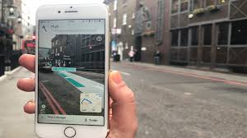
Existing System:

Slide 7
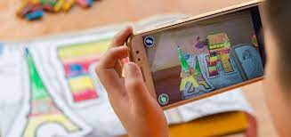
Proposed System:
In this system, an application for the digital classroom is presented. Teacher can show virtual videos on the screen with the help of unique image cards. This is achieved using Feature detection and matching. Feature detection and matching is an important task in many computer vision applications, such as structure-from-motion, image retrieval, object detection, and more. A feature is a piece of information which is relevant for solving the computational task related to a certain application. Features may be specific structures in the image such as points, edges or objects. The best role for augmented reality is as a supplementary tool. So, teachers can use it to bring lessons to life. Augmented reality is best suited to enhancing those traditional lessons.

Slide 8
Literature Survey:
TITLE | AUTHORS | DESCRIPTION | YEAR
Augmented Reality as a Resource for Improving Learning in the Physical Education Classroom | Antonio-José Moreno-Guerrero , Santiago Alonso García , Magdalena Ramos Navas-Parejo ,María Natalia Campos-Soto and Gerardo Gómez García | They used the parameters like data of participants with a total of 140 students in the subject of physical education. The sample generation technique has been applied in educational centers. | 2020
Augmented reality in teacher education. A framework to support teachers’ technological pedagogical content knowledge | Josef Buchner and Jörg Zumbach | They used the Technological Pedagogical Content Knowledge (TPCK) to review of the research literature on AR learning environments reveals that in most studies AR contributes to successful learning and increased motivation. | 2020

Slide 9
TITLE | AUTHORS | DESCRIPTION | YEAR
A Semantic Platform for Open Educational Augmented Reality Resources | Christian Grevisse, Carina Martins Gomes, Steffen Rothkugel | They used the Open Educational Resources (OER) has enabled the sharing of heterogeneous learning resources. Their retrieval can be improved by enriching their metadata using Semantic Web technologies. | 2020
Augmented Reality in Mobile Devices | Faculty of the Department of Software Engineering San JosState University In Partial Fulfillment of the Requirements for the Degree Master of Science By Sneha Kasetty Sudarshan May | They used some software frame works like Wikitude,Nexus, UMAR,DWARF, KHARMA,ALVAR, CloudRidAR by developers to focus on developing their high-level applications. | 2018

Slide 10
TITLE | AUTHORS | DESCRIPTION | YEAR
Recreation of history using augmented reality | Nilam Desai Assistant Professor, Smt. Chandaben Mohanbhai Patel | The parameters used in here are some images of historical objects for rebuilding of historical object to have realist view of time using Augmented Reality perceptrons. | 2018
Using augmented reality technologies for STEM education organization | V.V.Osadchyi , N.V.Valko2 and L.V.Kuzmich | The use of augmented reality technology improves the learning of individual students, their motivation, As the topic of augmented reality in education is quite new and little studied for STEM education | 2020

Slide 11
Methodology:
Authenticating the lecturers into the app.
Processing the image card or gesture shown by the lecturer.
Analyzing the image card and performing feature detection.
Comparing features of this image card with those in the database.
Presenting the video corresponding to the most similar image in the database .

Slide 12
Architecture
Input line Video feed
ORB based object recognition
AR video overlapping

Slide 13
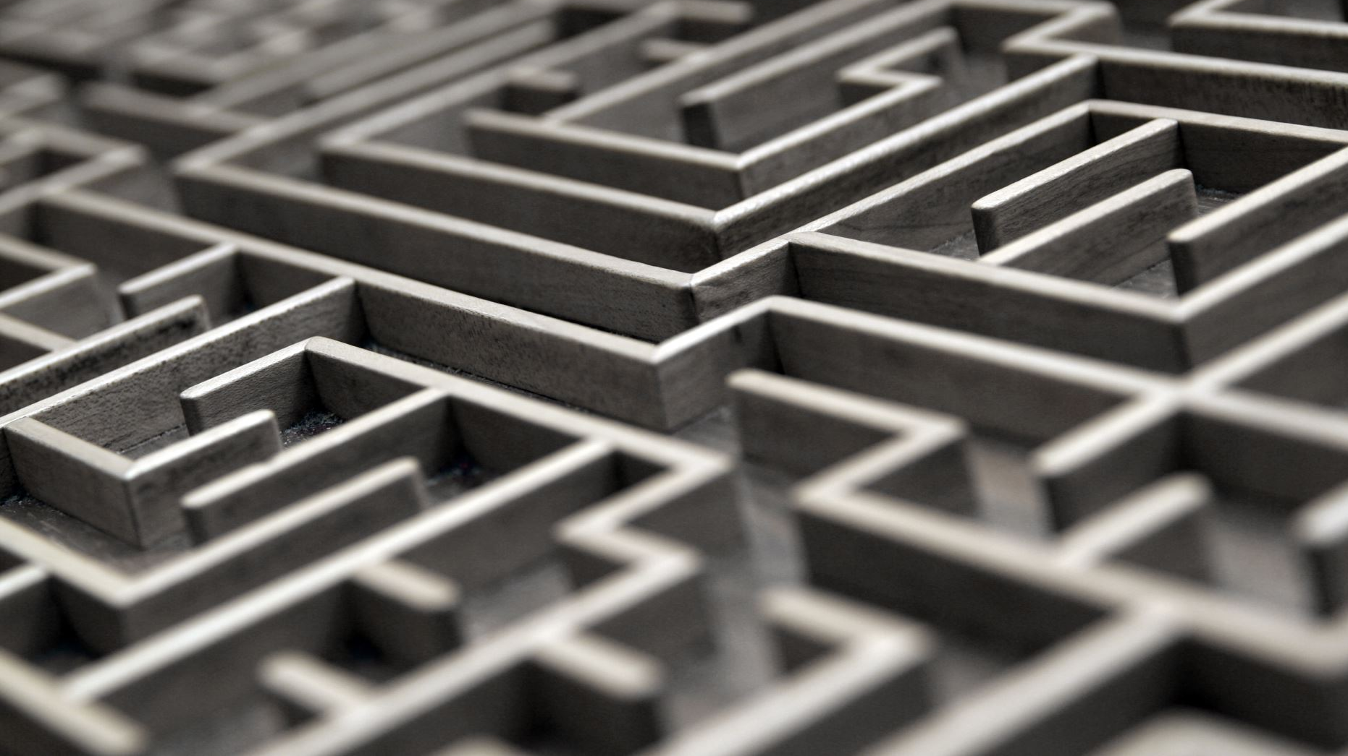
Feature Detection:
Oriented FAST and Rotated BRIEF (ORB) is used in detecting features in a particular image. ORB performs as well as SIFT (Scale-invariant feature transform) and better than SURF (Speeded up Robust Features).
ORB is a fusion of FAST key point detector and BRIEF descriptor with some modifications.
Initially to determine the key points, FAST is used. Later Harris Corner measure is applied to find the top N points.

Slide 14
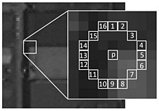
Fast (Features from Accelerated and Segments Test):
For a given pixel the fast compares the brightness of p to its surrounding 16 pixels. Those surrounding pixels are then sorted into three classes (pixels lighter than p, pixels darker than p and pixels similar to p). A pixel p is selected as a key point if it has more than 8 pixels darker or brighter than p in its surrounding.
This Fast determines the edges in an image So keypoints found by fast gives us information of the location edges in an image.

Slide 15
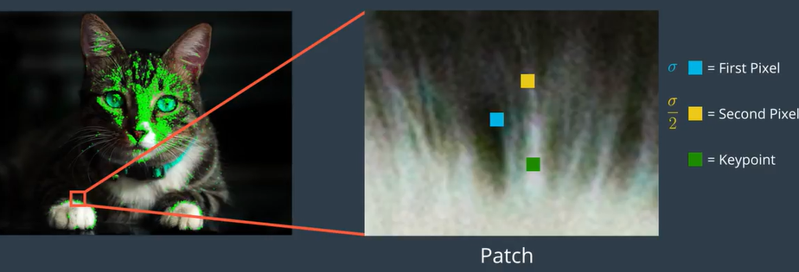
Brief (Binary Robust Independent Elementary Feature):
Brief takes all the keypoints generated by fast as input and convert it into a binary feature vector. Each keypoint is described by a feature descriptor which is 128-512 bit string.
In order to prevent descriptor from being sensitive to high-frequency noise, Brief smoothens the image using Gaussian Kernel.
Brief selects a random pair of pixels in a defined neighborhood (patch) around that keypoint. The first pixel in the random pair is drawn from a Gaussian distribution centered around the keypoint with a spread of sigma. Then the second pixel is drawn from Gaussian distribution centered around first pixel with standard deviation or spread of sigma by two. If the first pixel is brighter than second, then it assigns 1 to its corresponding bit or else 0.

Slide 16
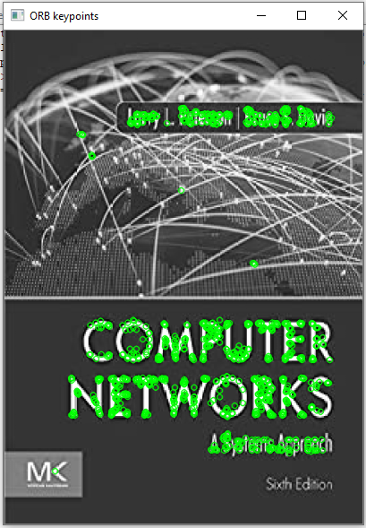

Feature Detection Result:
Keypoints for a particular image using orb is shown. First the original image is rescaled and converted into grayscale. Then this gray scaled image is scanned and the keypoints are found using orb and then they are represented as that of in the given image.

Slide 17
Feature Matching:
Initially the video input is taken from the camera and it is divided into frames. Then each frame is scanned to obtain the keypoints and descriptors. Then these descriptors are compared with those of the input image present in the database. If the number of matches are more than the threshold value then the matches are drawn.
Flann based matcher is used to match the descriptors. Flann stands for Fast Library for Approximate Nearest Neighbors. Fast image search can be carried out via Hamming distance measurement.

Slide 18
Flann based Matcher:
This descriptor matcher contains a collection of algorithms optimized for fast nearest neighbor search in large datasets and for high dimensional features.
For Flann matcher we need to pass two dictionaries. First one is IndexParams which describes the algorithm to be used. The second one is SearchParams which specifies the number of times the trees in the index should be recursively traversed.
Then the descriptors of the input image and the frame retrieved from the camera are compared and the matched features are represented.

Slide 19
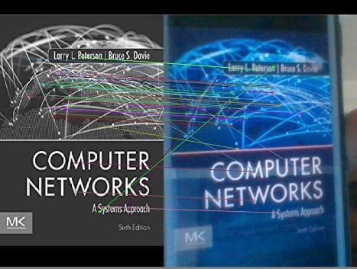
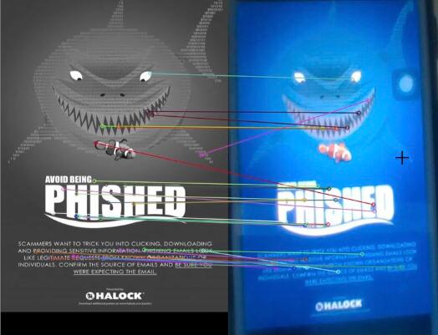
Feature Matching Result:
Each image contains the camera frame image and the image from the database to which the image retrieved from the frames of the video through camera and the features that are matched.

Slide 20
Virtual Reality:
Virtual reality is viewing a video in 3D using special 3D glasses that gives users the immersive experience of being a part of that 3D movie.
First the camera sensor is activated and the cartoon image is shown in order to play it’s corresponding video. Then the features are recognized in this frame and are compared to those images present in the database.
ORB has been used for feature detection and BFmatcher (Brute Force) for feature matching.

Slide 21
Output Description:
Once the features are detected and compared the image in the database which is most similar to the image shown by the user is determined.
Then the video corresponding to the image is retrieved and played to the user. This is achieved by ffpyplayer module in our project.
At the end of the video the program waits for an instruction whether to quit or continue; if the program hasn’t received any exit instruction then again the process gets repeated.

Slide 22
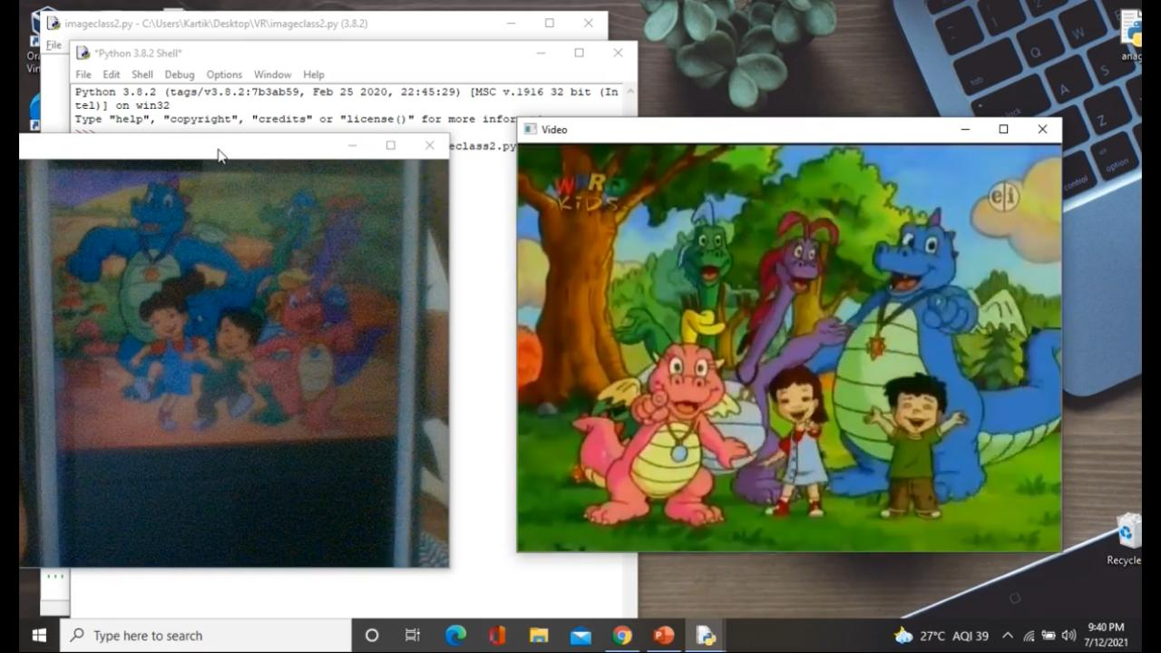
Output:
https://drive.google.com/file/d/1puhIK8qnX26u0ZgXv0amkvB6gSyiaNk0/view?usp=sharing
A video will be played to the corresponding image shown as that of in the picture. The complete video execution is available in the above provided link.

Slide 23
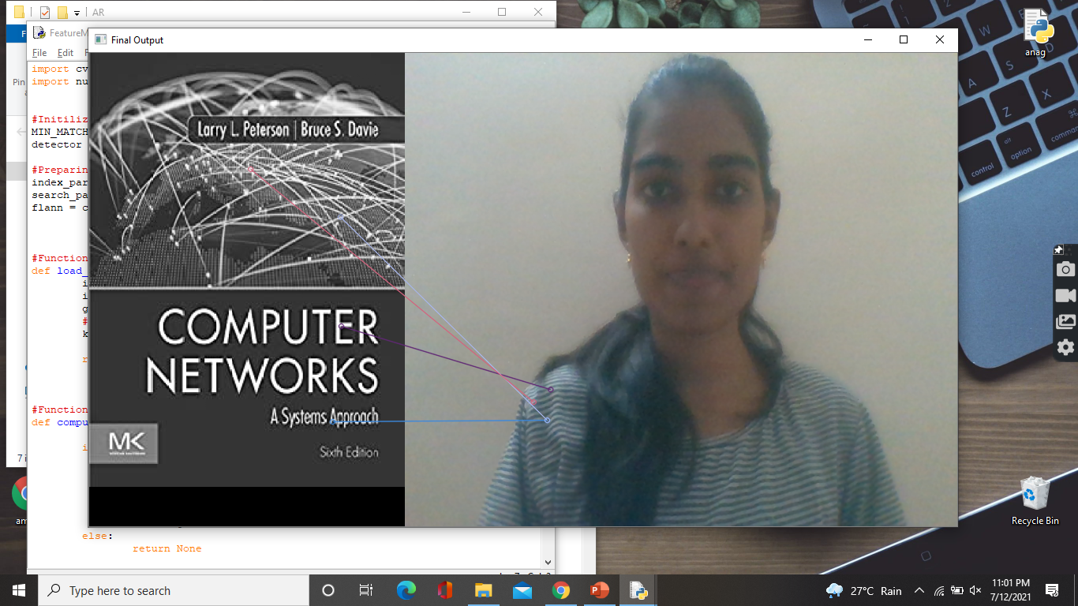
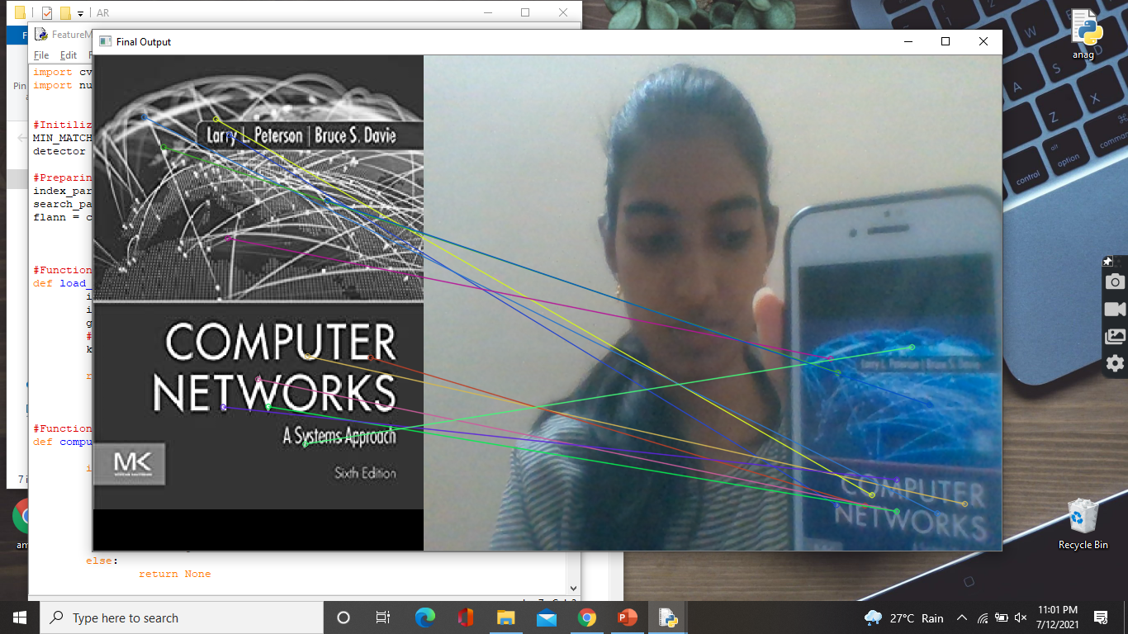
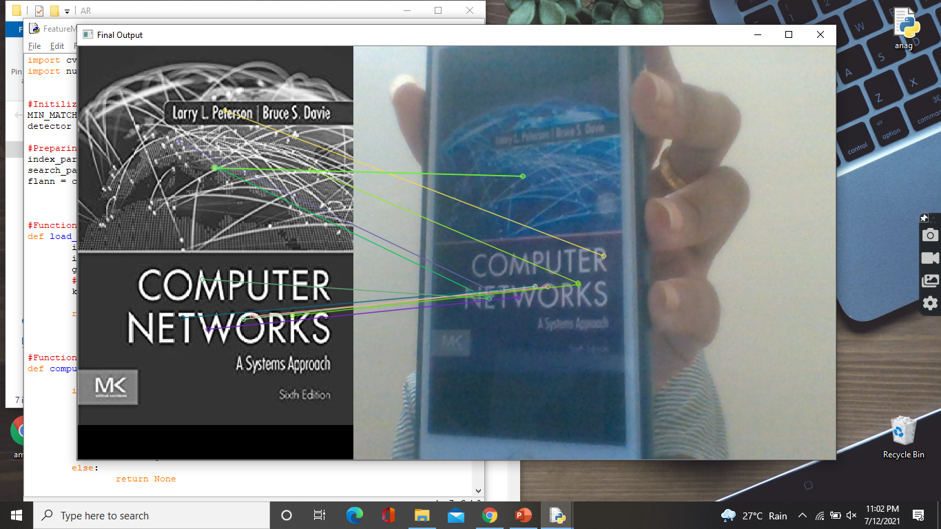
Results:

Slide 24
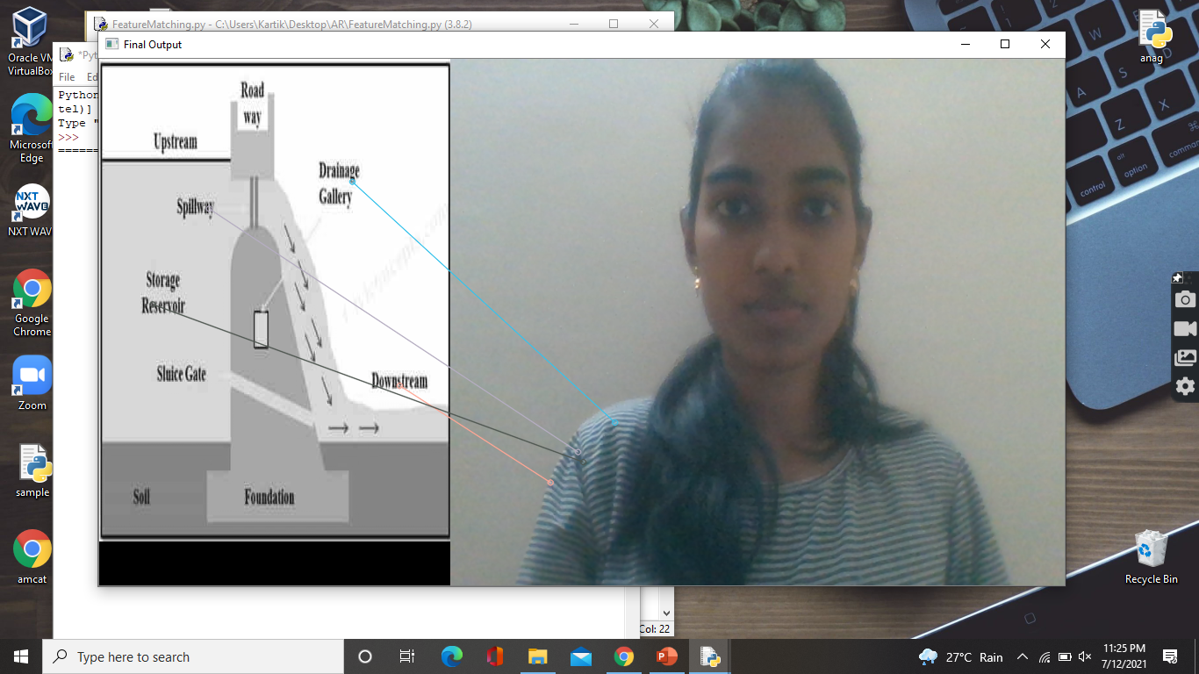
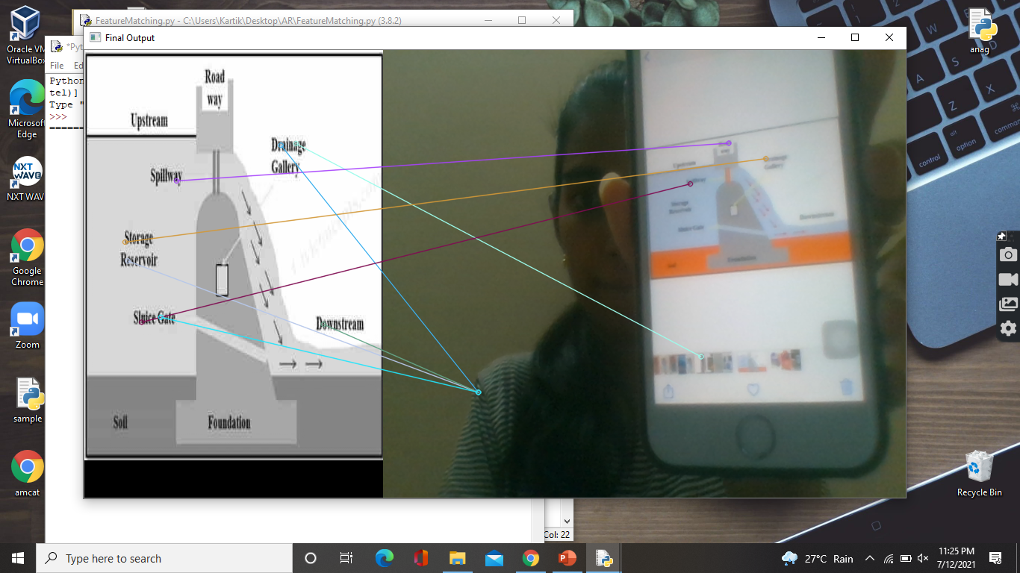
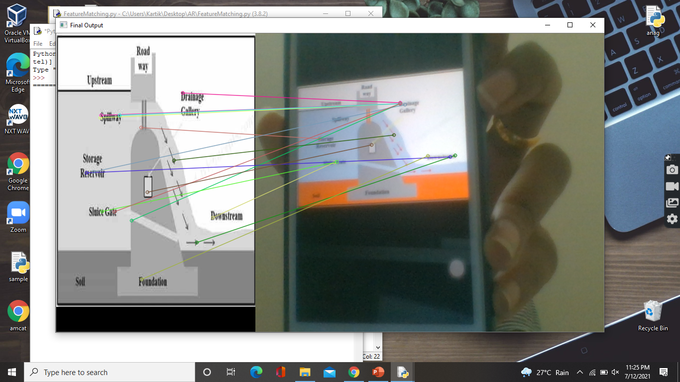
Output 2:

Slide 25
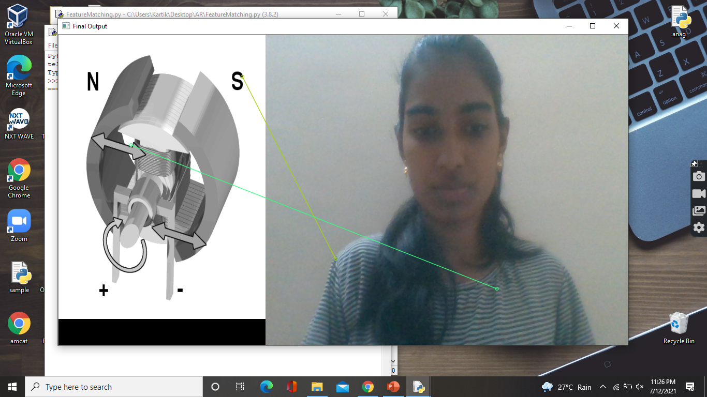
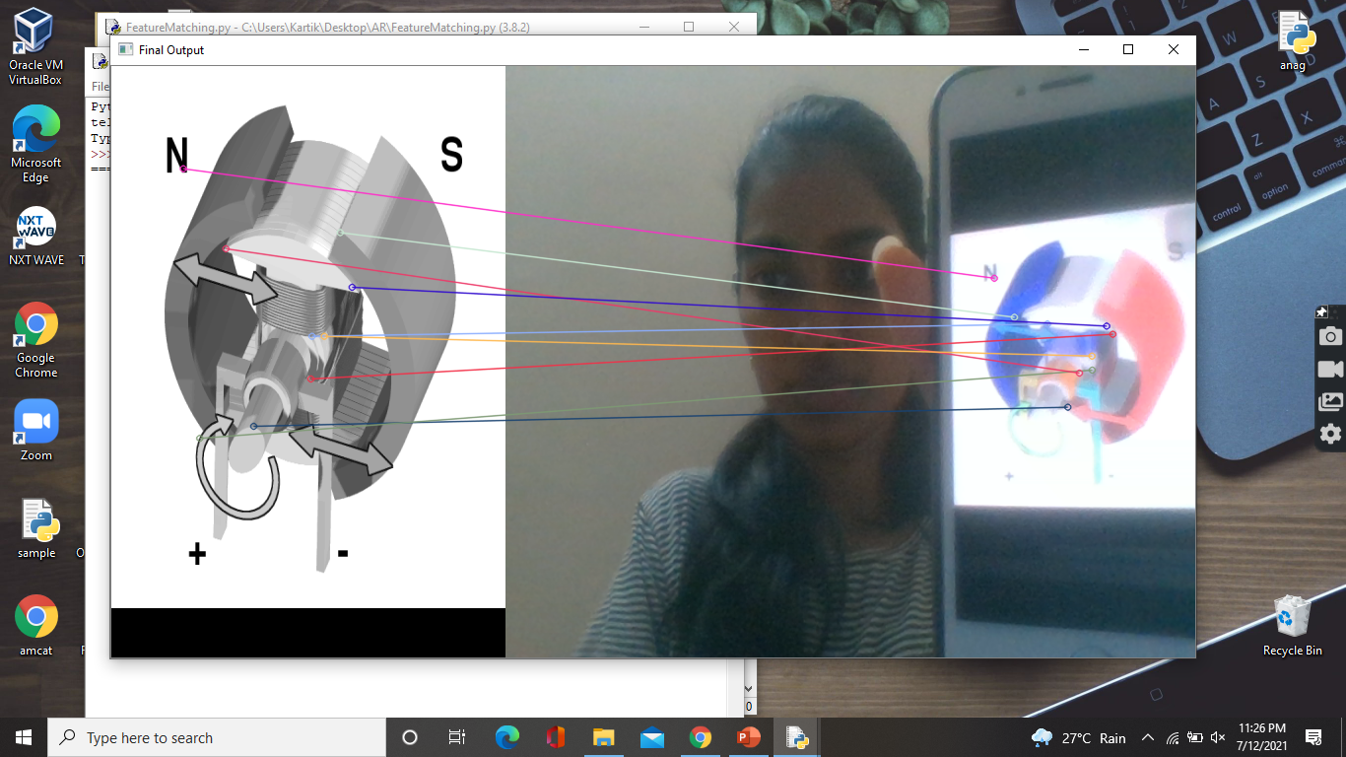
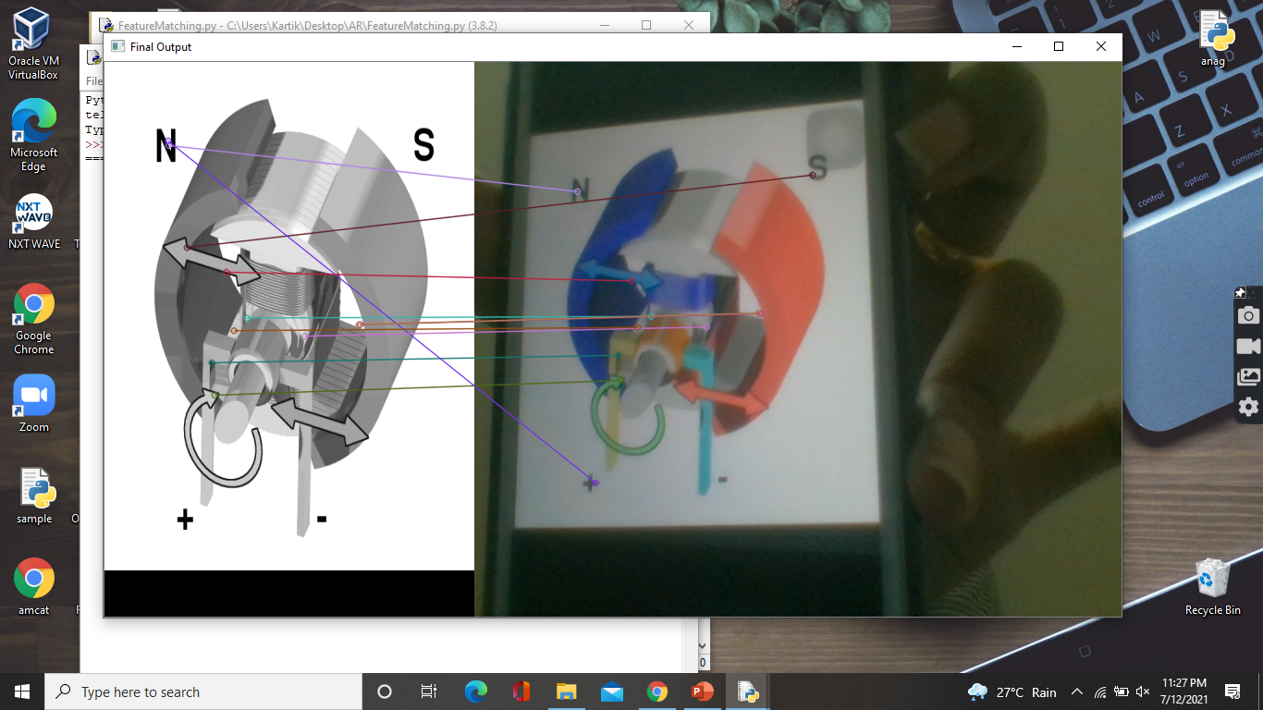
Output 3:

Slide 26
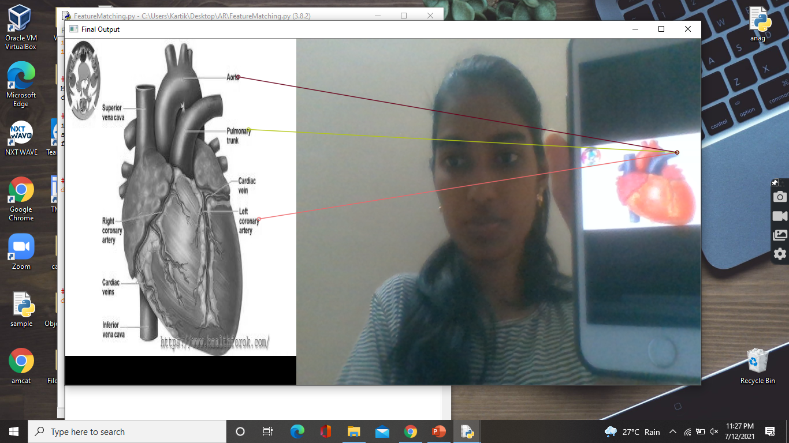
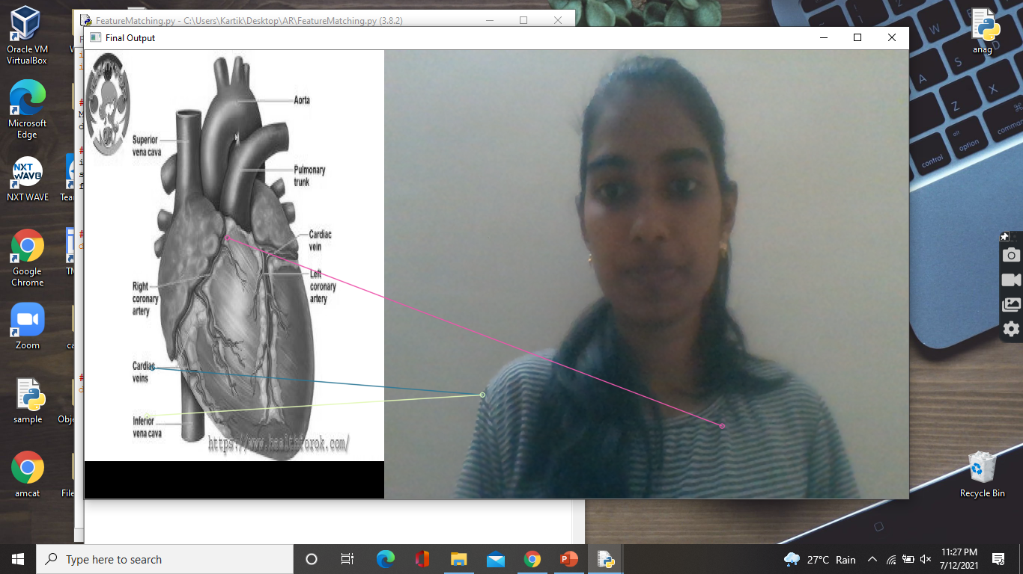
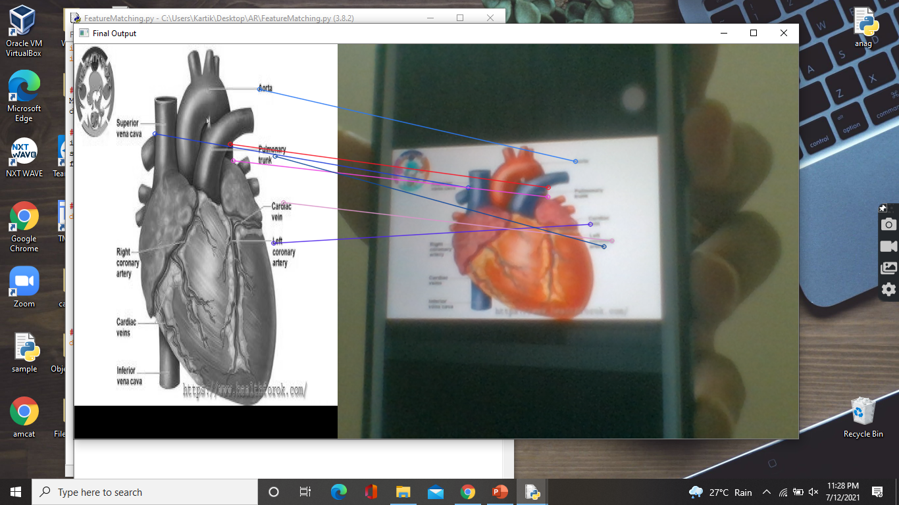
Output 4:

Slide 27
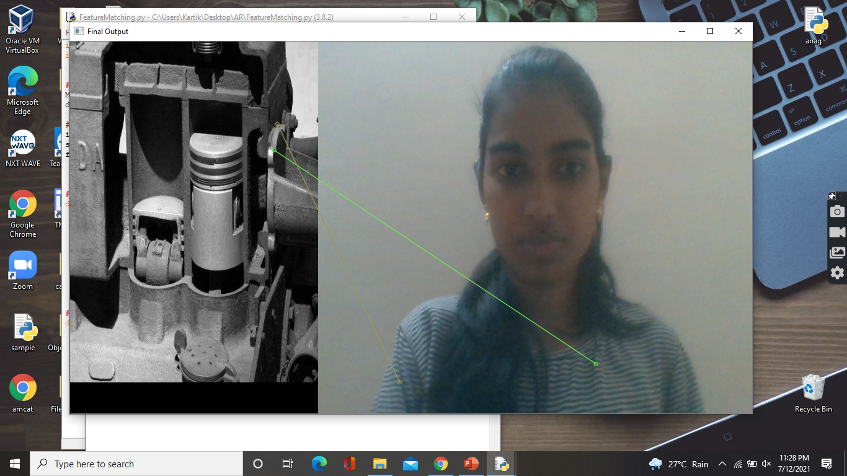
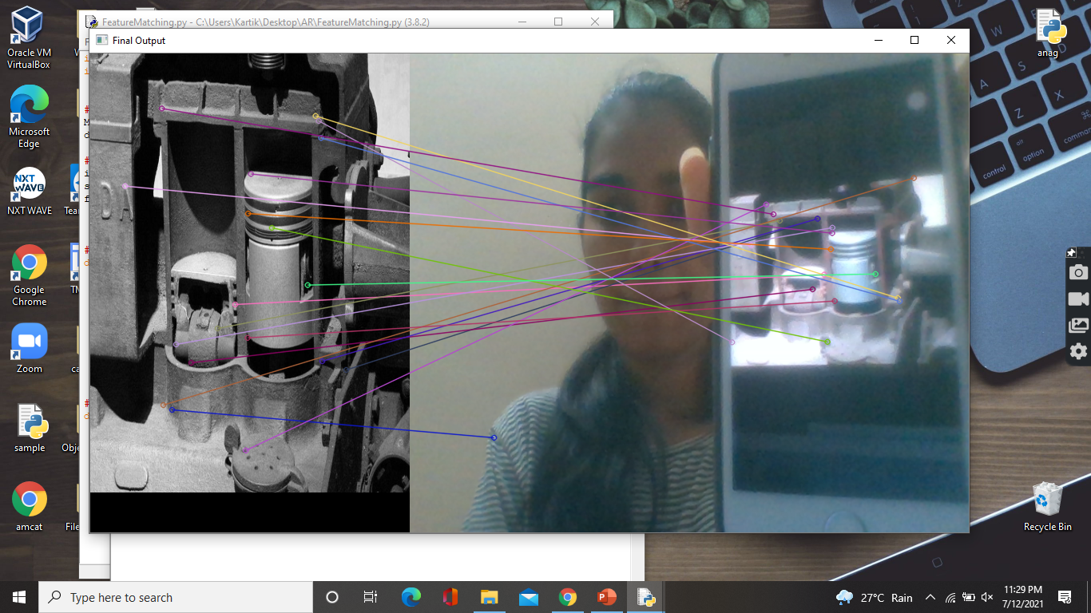
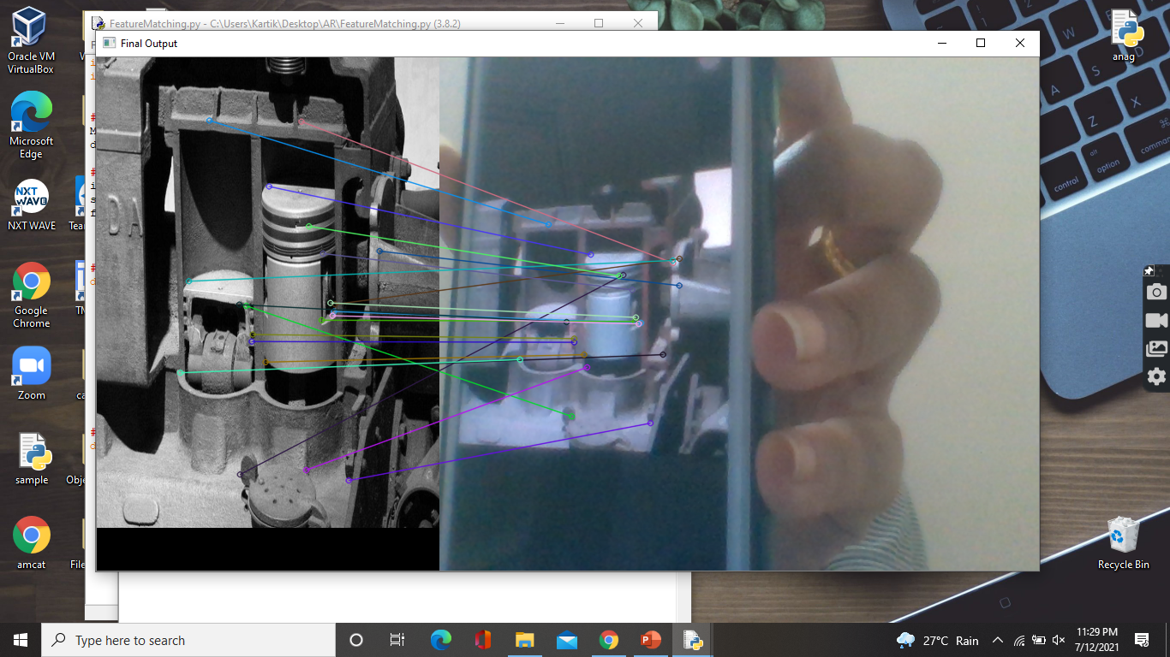
Output 5:

Slide 28
References:
https://www.researchgate.net/profile/Sneha_Kasetty_Sudarshan/publication/320704050_AUGMENTED_REALITY_IN_MOBILE_DEVICES/links/59f61d880f7e9b553ebd25e3/AUGMENTED-REALITY-IN-MOBILE-DEVICES.pdf
https://www.researchgate.net/profile/Nilam_Desai2/publication/324110139_Recreation_of_history_using_augmented_reality/links/5ac70cf6a6fdcc8bfc7f8f67/Recreation-of-history-using-augmented-reality.pdf
https://www.google.com/url?sa=t&source=web&rct=j&url=https://ieeexplore.ieee.org/document/9327922&ved=2ahUKEwjpjf7Hl97xAhUnwjgGHWngB00QFnoECAMQAQ&usg=AOvVaw0nFIQgfrppETtxvTyWj7sa&cshid=1626115534369

Slide 29
References:
https://www.google.com/url?sa=t&source=web&rct=j&url=https://pubmed.ncbi.nlm.nih.gov/32455778/&ved=2ahUKEwiGisqvlt7xAhWZwzgGHdR-A9UQFnoECAUQAQ&usg=AOvVaw0TzGf_Z_zATHFVWs2yiiWE
https://www.google.com/url?sa=t&source=web&rct=j&url=https://ijet.itd.cnr.it/article/download/1151/1083/&ved=2ahUKEwjg1bX4lt7xAhXEwTgGHQw-DHkQFnoECBgQAQ&usg=AOvVaw1Dt94eLWqsfzCgTN7Bvp5Q
https://www.google.com/url?sa=t&source=web&rct=j&url=https://iopscience.iop.org/article/10.1088/1742-6596/1840/1/012027/pdf&ved=2ahUKEwjWxO-MmN7xAhVZ4jgGHet0DpkQFnoECAcQAQ&usg=AOvVaw1YOkYXNl15Ba68s2kF9pe3

Slide 30
Conclusion:
In this project an easy way of teaching online classes with video explanation is done by using Augmented reality. ORB is used for Feature detection and Flann based matcher is used for Feature Matching to produce accurate results.
A Virtual reality model is also developed where a particular video is played based on the image shown by the user. Even here ORB is used for feature detection and matching. Ffpyplayer is used for playing the corresponding video.

Slide 31
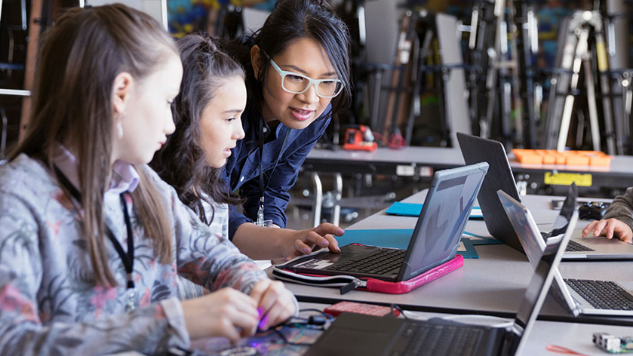
Thank you.

